Slide 1
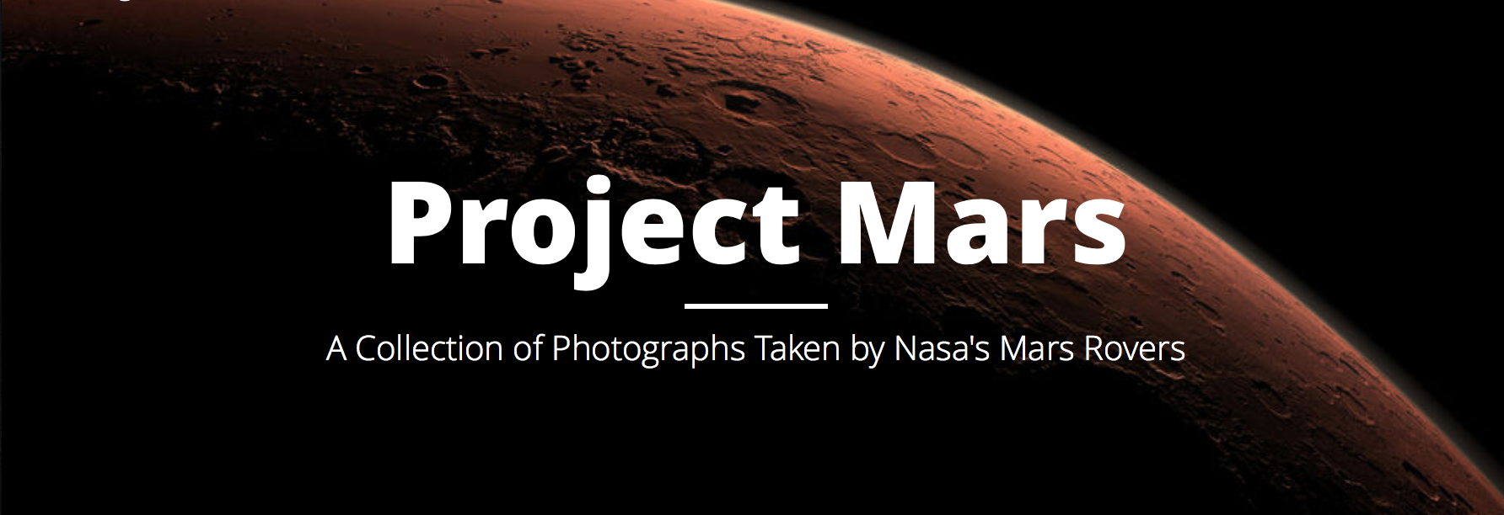
Project Mars
War Eagle Code
Jacob Laney and Joseph Cauble
Sophomores (Software Engineering)

Slide 2
Introduction
Members:
Jacob Laney
Joseph Cauble
Sophomores studying Software Engineering

Slide 3

Client-side design
Dynamic Interfaces
Client-side processing
Enhanced development time
Fewer computing resources
Fun

Slide 4
NASA Rover Image Selection
Broke filtering into separate processes
Evaluated each step before advancing
Rover -> Date -> Camera -> Image Library
Informed our decisions on user interface implementation

Slide 5
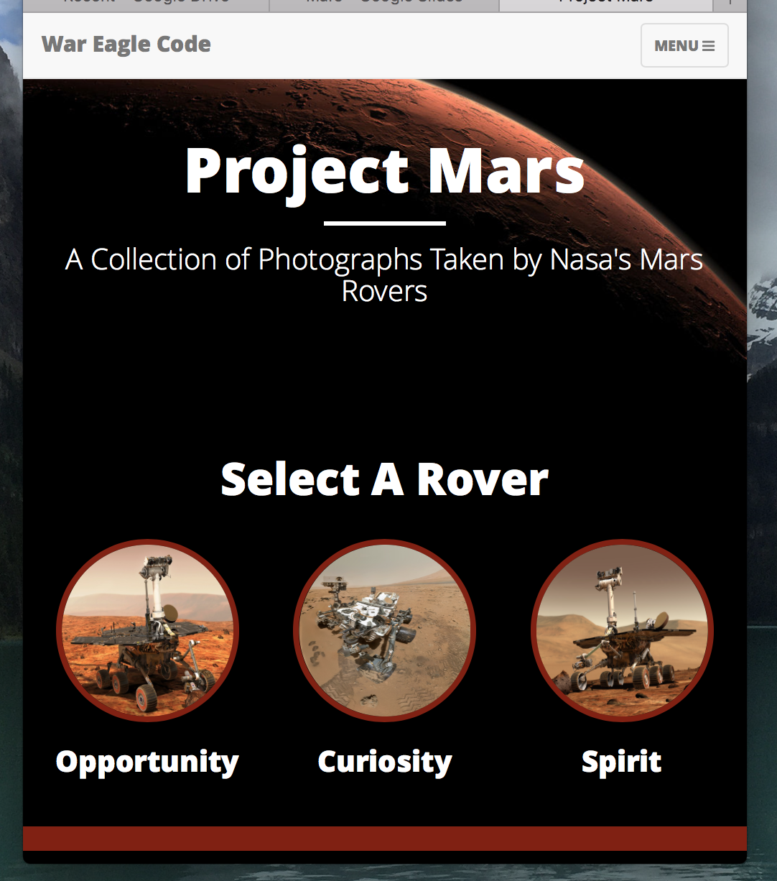
Responsive Design

Slide 6
Challenges
NASA implemented a CORS (Cross-Origin Resource Sharing) system on their remote server, but didn’t make it public for all resources.
User experience
Speed
Collaboration
Learning new technologies

Slide 7
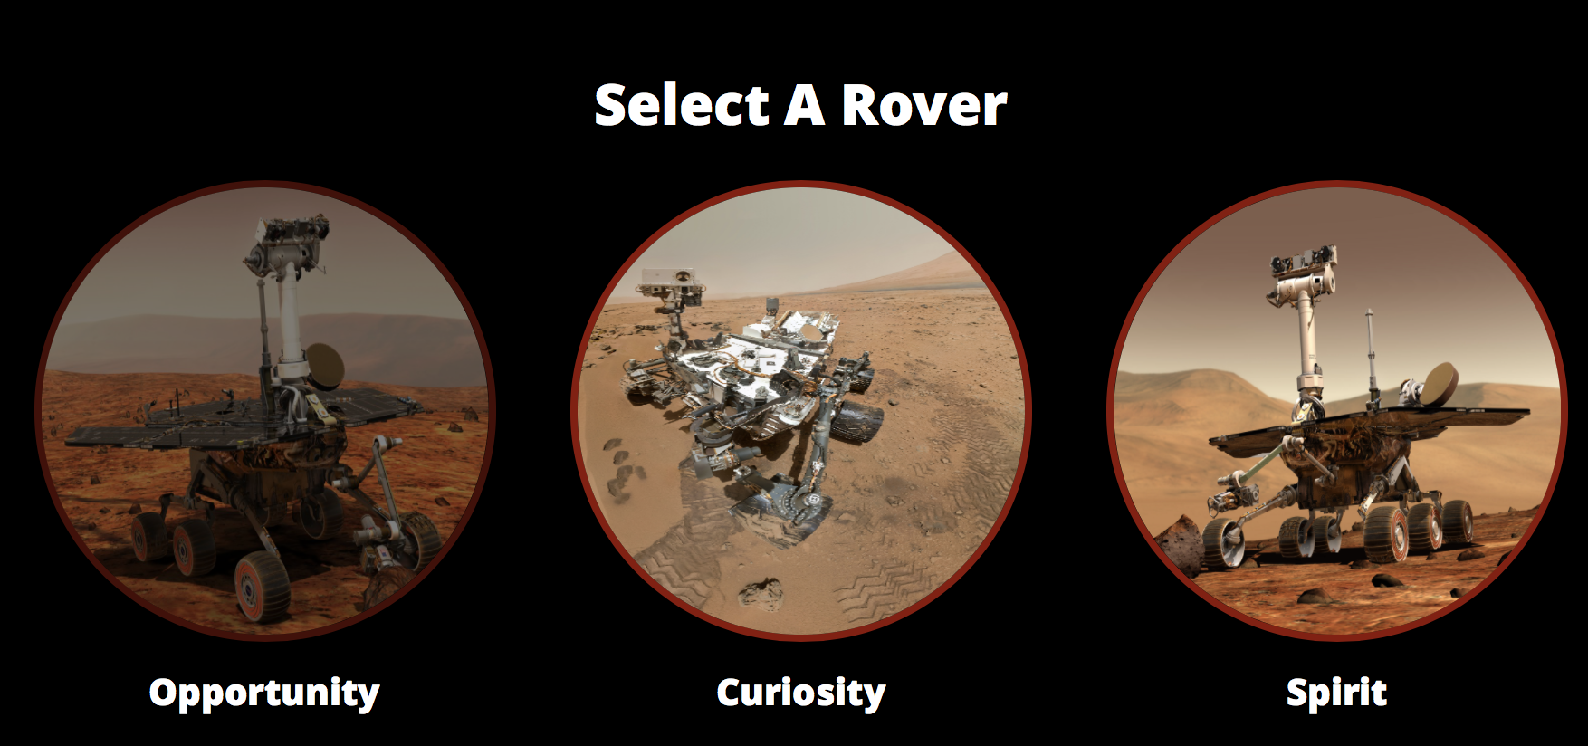
War Eagle Code - Project Summary
User Features:
Select Rover
Select Date and Camera
Displays NASA images as thumbnails
Inspect thumbnails
Technologies used:
Angular.Js
HTML5
CSS/Bootstrap
Technical Features:
Fully responsive
Client-side design

Slide 8
Demo

